Slide 1
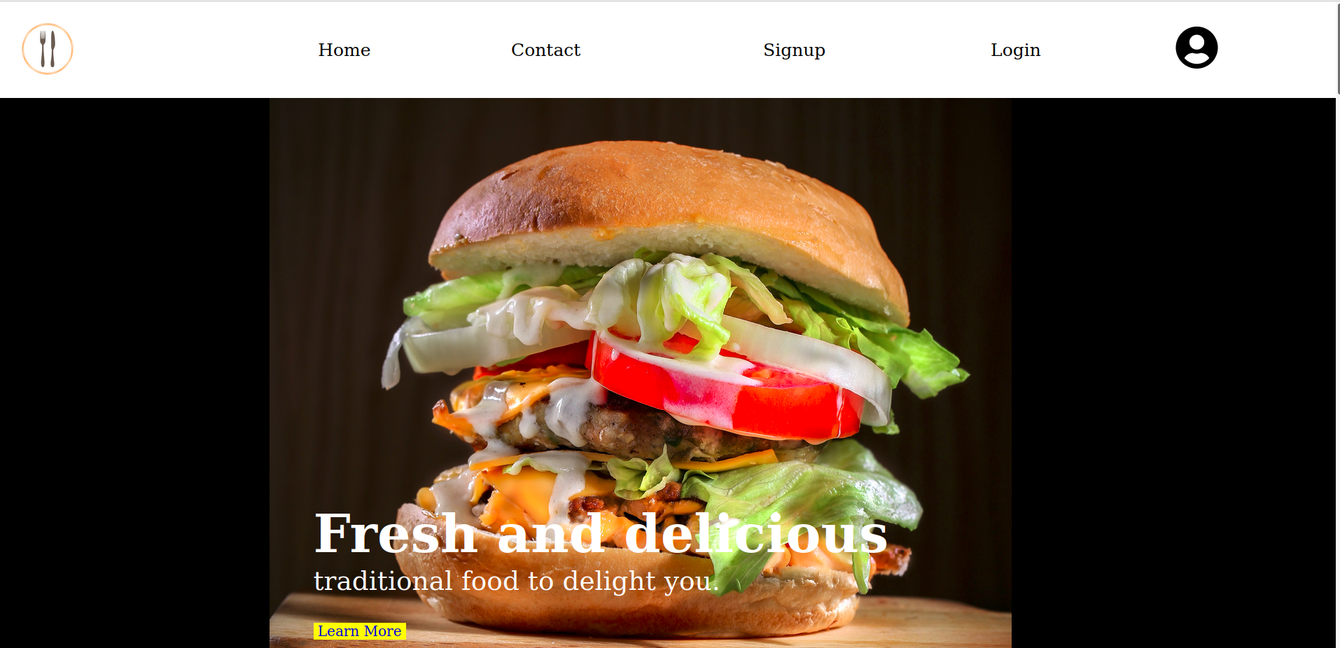
DBMS Mini Project
Night Canteen Online Booking System
Team Members: Evalutor:
1. Abhinav Gupta Kamna Sai charan
2. Aniket Srivastav
3. Sunil Yadav

Slide 2
Home Page of Website
Contributed By: Abhinav Gupta
Languages: Html, CSS and JavaScript
This Page contain all Navigation links and highlights main features of night canteen and contain navigation links and location of the Canteen.

Slide 3
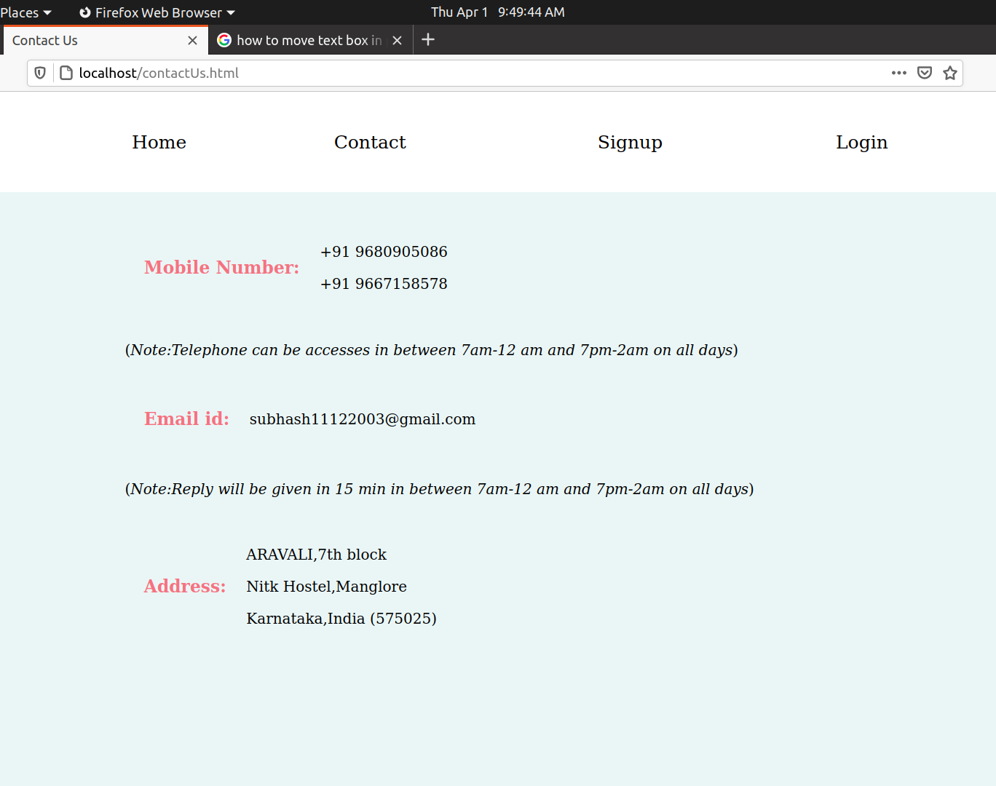
Contact Page
Contributed By: Sunil Yadav
Languages: Html, CSS
This page Provide the contact details and working hour of canteen.

Slide 4
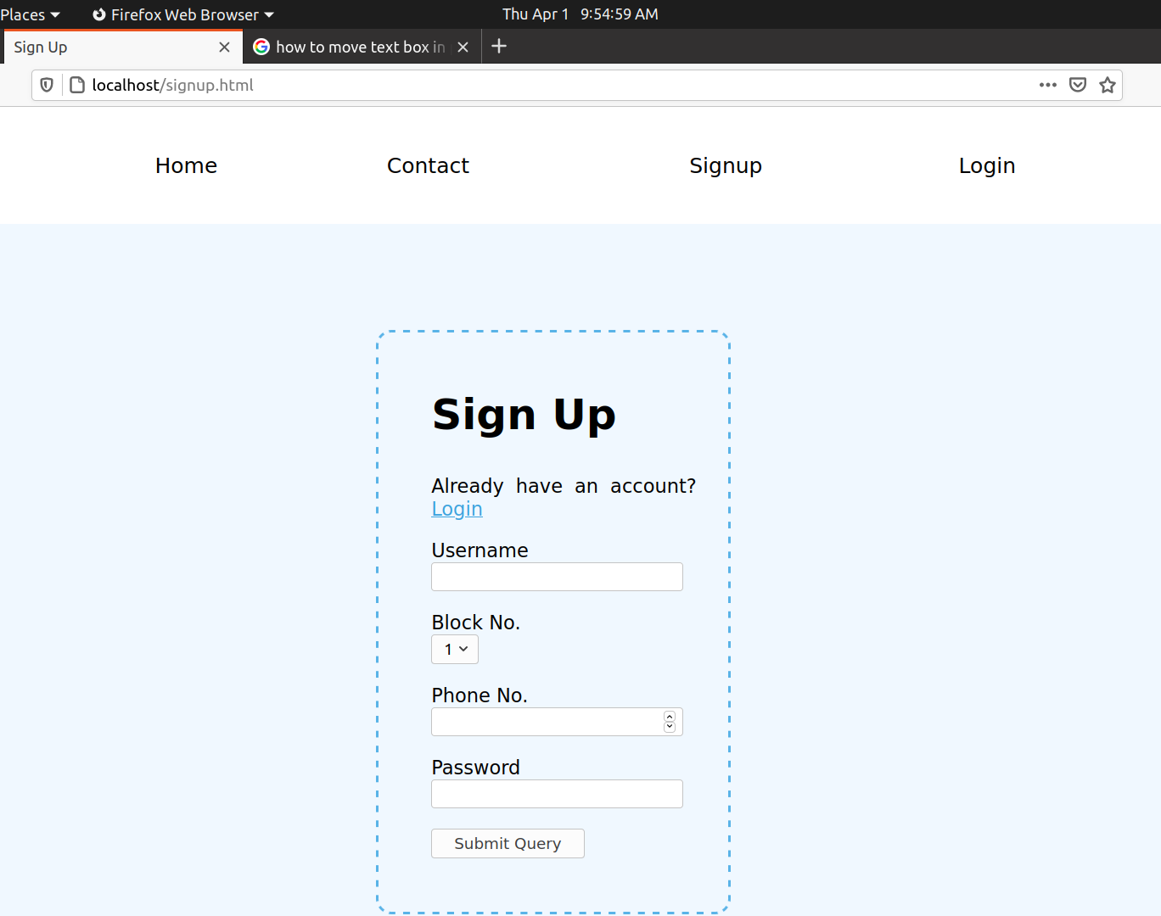
Signup Page
Contributed By: Aniket Srivastav
Languages: Html, CSS
This page takes users signup credentials and insert into the database if everything is correct

Slide 5
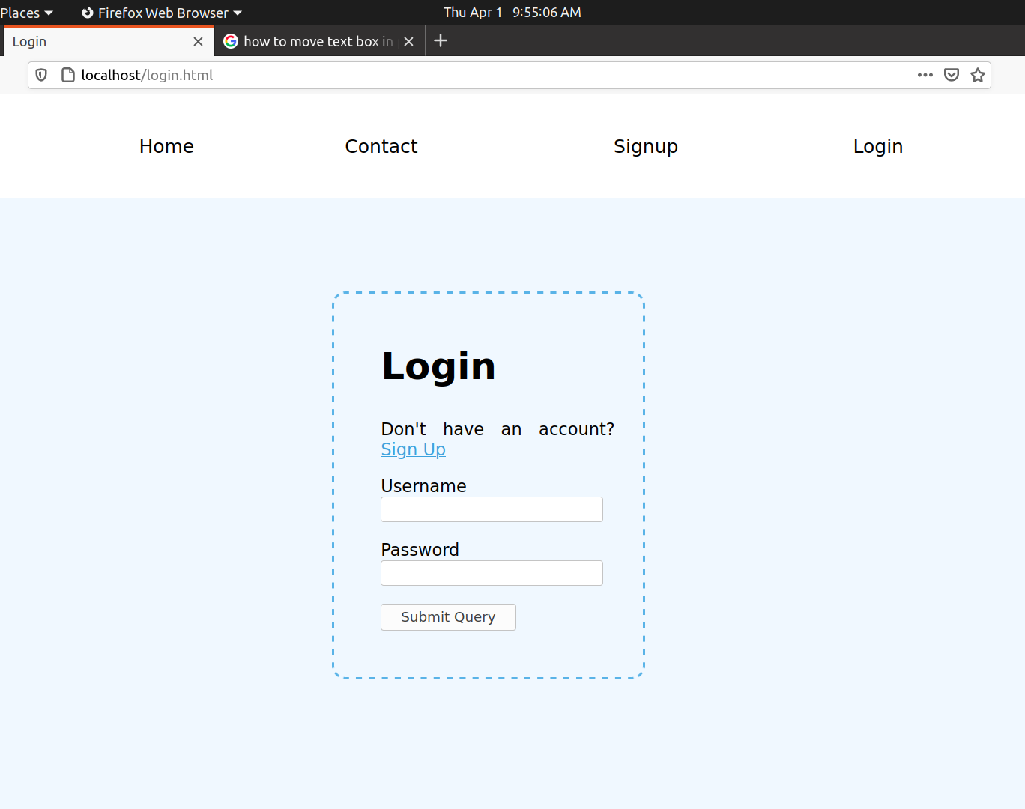
Login Page
Contributed By: Aniket Srivastav
Languages: Html, CSS
This page takes users login credentials and match it with the database if everything is correct then direct to the Home page of user.

Slide 6
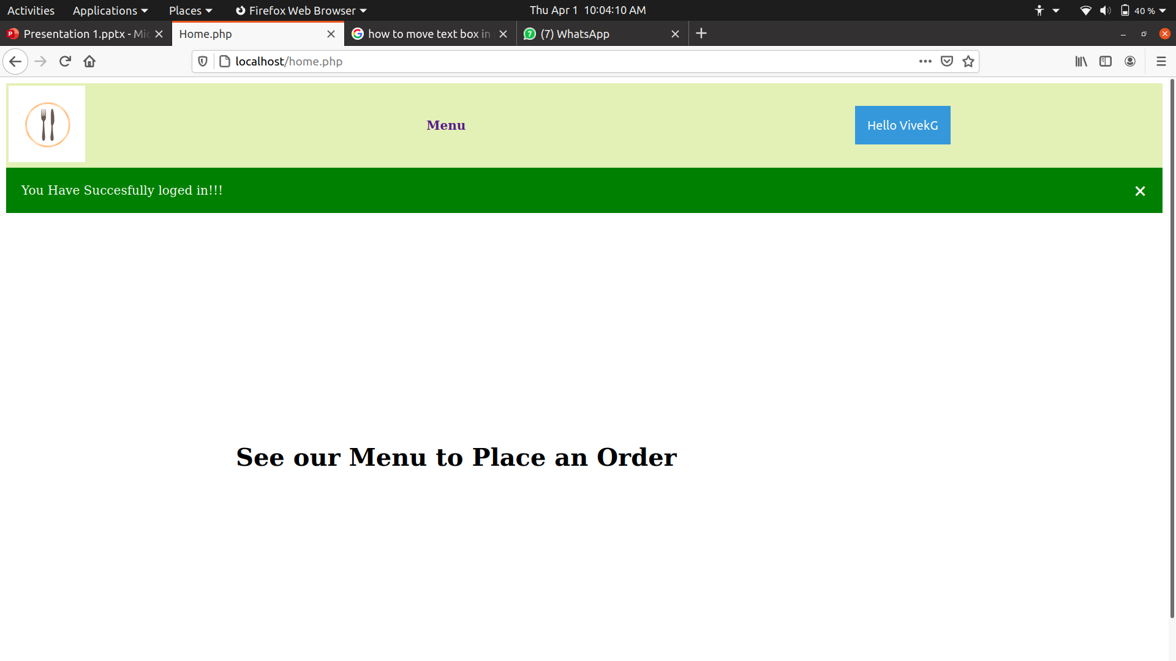
Home Page of User
Contributed By: Abhinav Gupta
Languages: Html, CSS,PHP
This is Home page for the User after the signin.it contains all navigation links for further action.

Slide 7
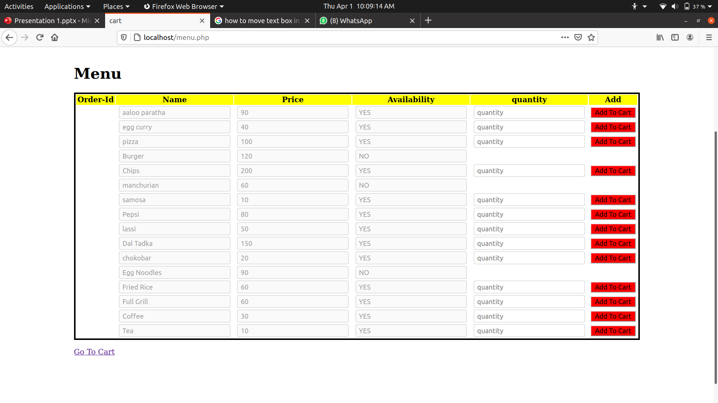
Menu Page of items
Contributed By: Aniket Srivastava
Languages: Html, CSS,PHP
This is Menu page for the Food-items, it show all dishes with price and availability, takes quantity and add to the cart.

Slide 8
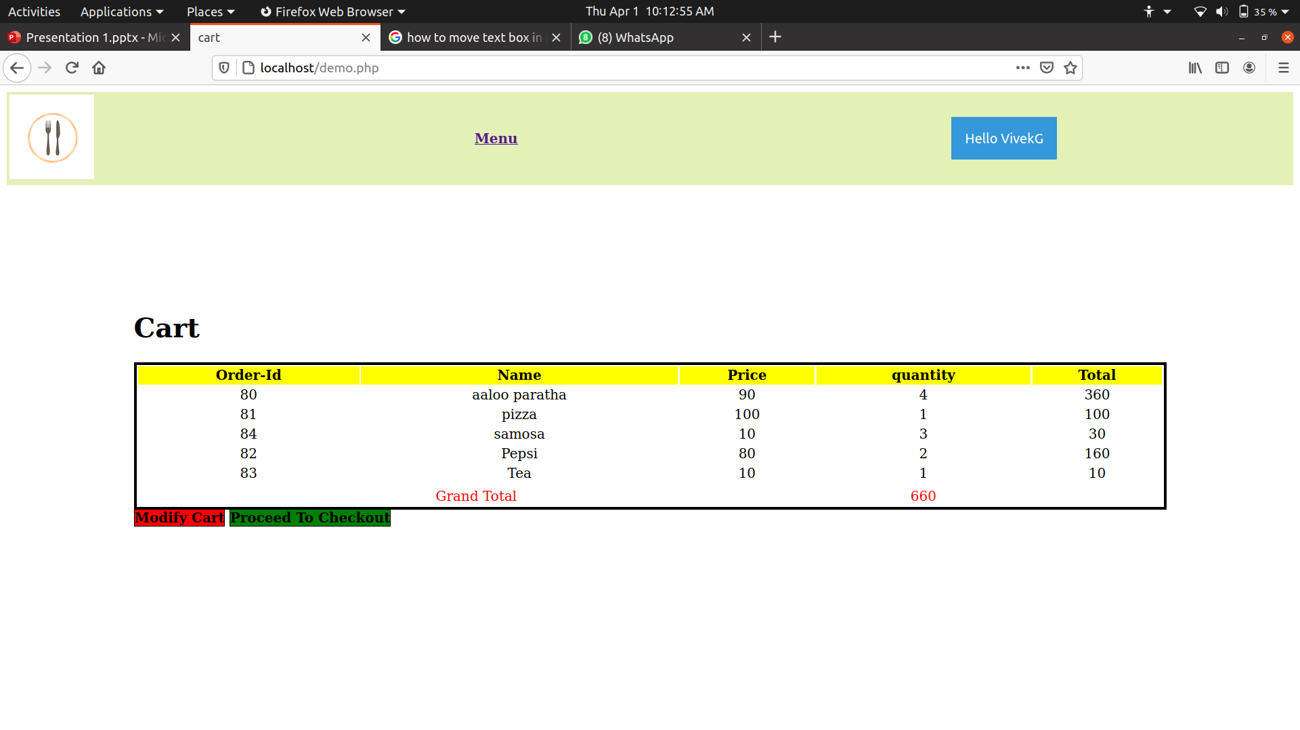
Cart Page of items
Contributed By: Abhinav Gupta
Languages: Html, CSS, PHP, JavaScript
This is Cart Page. It shows all the item in the Cart with the total price, and give two option either to modify cart or proceed to cart.

Slide 9
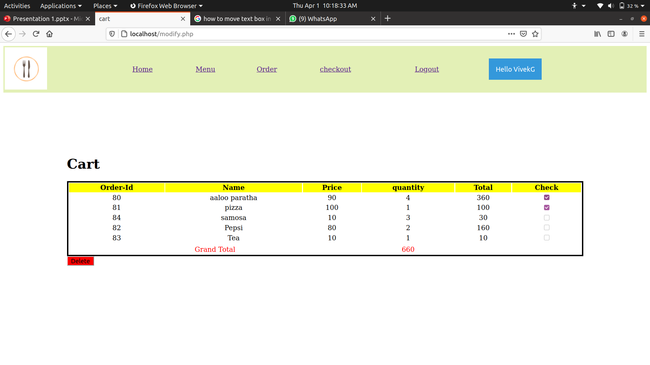
Modify Page of items
Contributed By: Abhinav Gupta
Languages: Html, CSS, PHP, JavaScript
This is Modify Page. It shows all the item in the Cart with the name, price, quantity and total and with a check box to select the item to be deleted and after selecting the check box a delete button to delete those items.

Slide 10
Modify Page of items
Contributed By: Abhinav Gupta
Languages: Html, CSS, PHP, JavaScript
This is Modify Page. It shows all the item in the Cart with the name, price, quantity and total and with a check box to select the item to be deleted and after selecting the check box a delete button to delete those items.

Slide 11
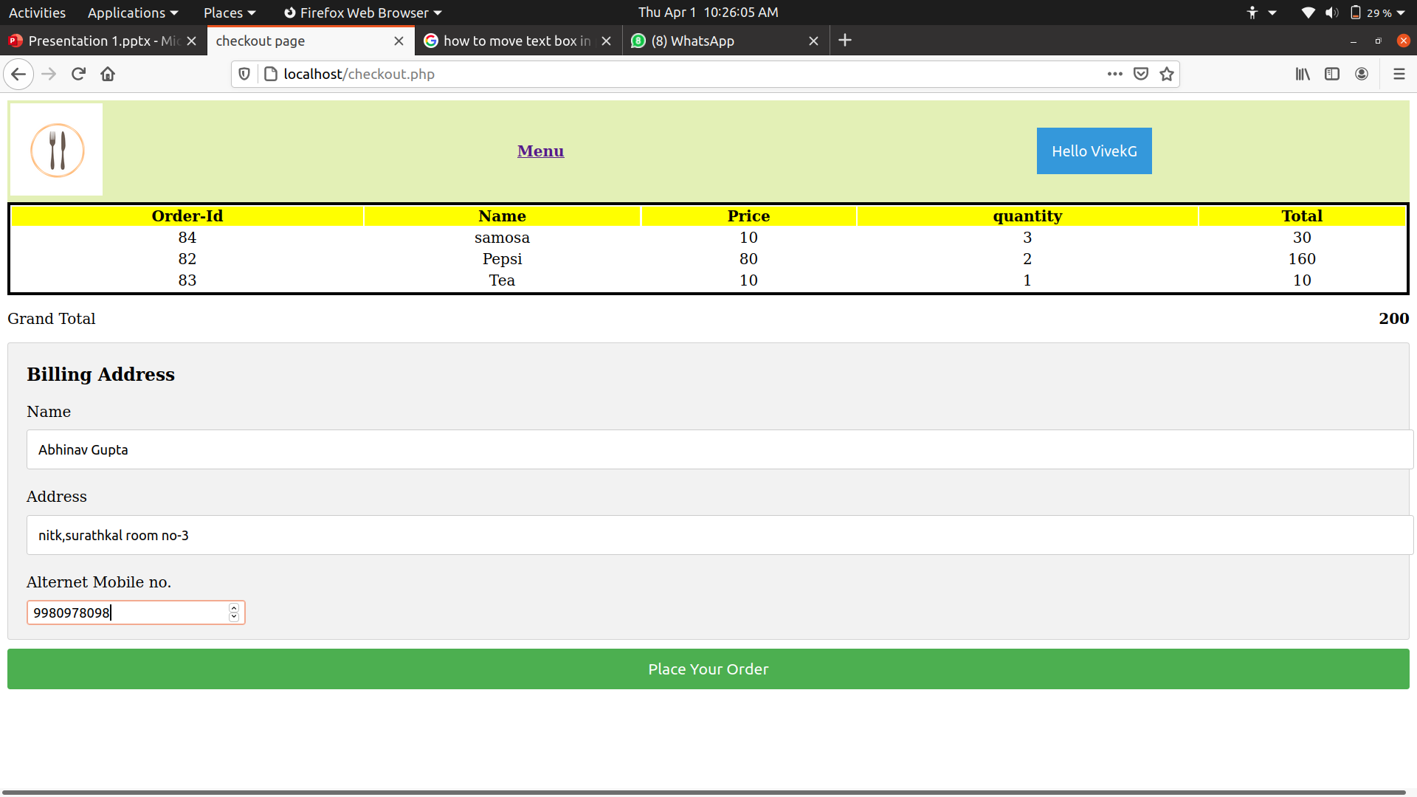
Checkout Page
Contributed By: Abhinav Gupta
Languages: Html, CSS, PHP, JavaScript
It shows all the item in the Cart with the name, price, quantity and total which will be ordered, then takes shipping address and places the order.

Slide 12
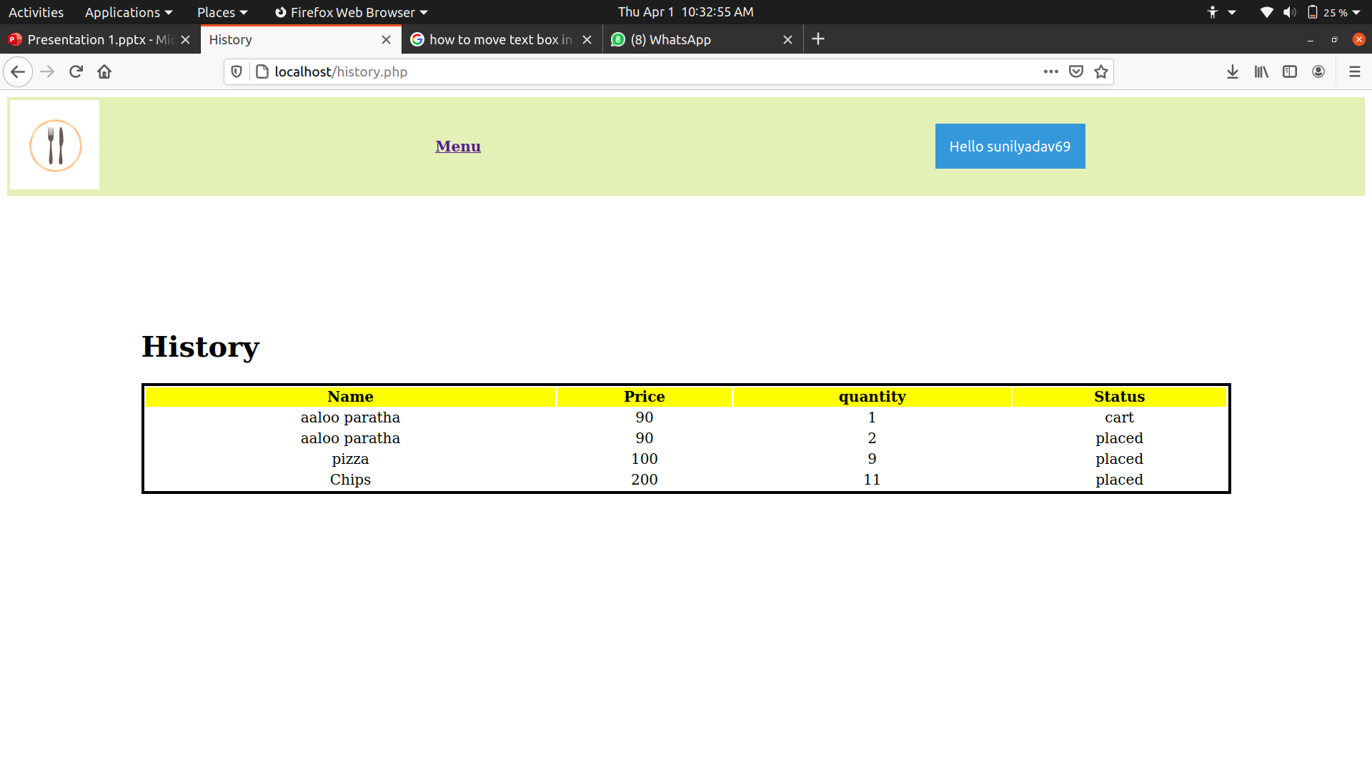
History Page
Contributed By: Sunil Yadav
Languages: Html, CSS, PHP, JavaScript
It shows all the item which has been ordered before by the user.

Slide 13
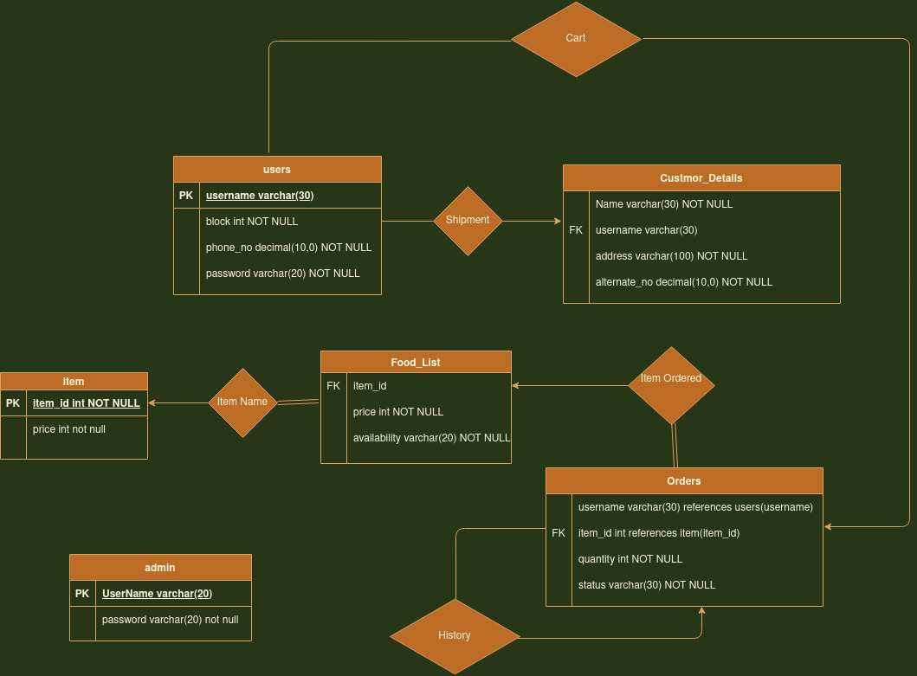
ER Diagram
We have 6 tables.
(i). Users- table keep the username, password, block and mobile number of the user.
(ii). Admin- It keep the username and password for the admin of the website who has the access to see, modify the orders, availability and other thing of database.
(iii). Item- it store the name of item, and has item_id as the primary key.
(iv). Food-List – Store the price and availability of item with the item_id.
(v). Costumer-details :-store the username, name, address and alternative number.
(vi). Order:- store the quantity of each item, with the status , item_id, and username who placed the order.

Slide 14
Thank You

